Slide 1
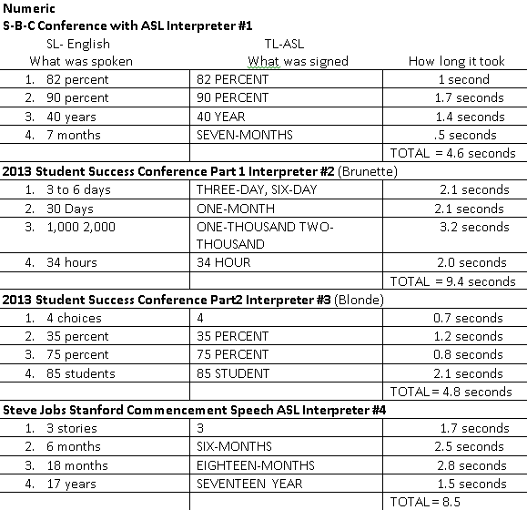
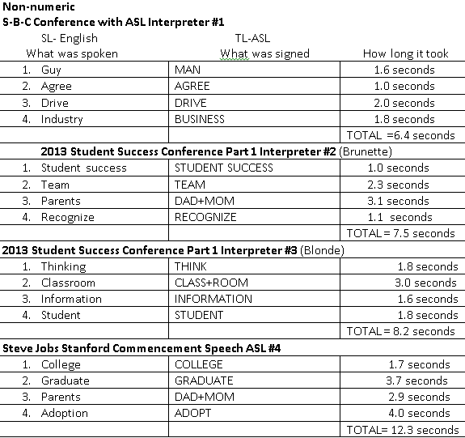
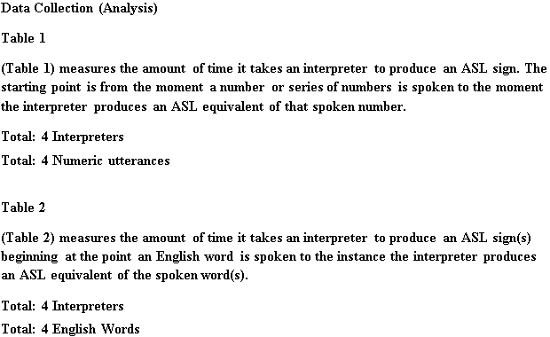
Do numbers spoken in the source language impact the amount of time it takes interpreters to process the source information before they can produce it?
By Takiya Lyles
Introduction
The ability to accurately measure and express the cognitive process interpreters go through may be a challenge because these processes cannot be directly observed.
Data Collection & Analysis
Methods & Material
Five video clips from platform settings were analyzed. The first set of videos included a team of two interpreters. The second set had one interpreter working the full duration of the conference alone. The last video was a side by side video interpretation of a university commencement speech using one interpreter. All of these videos can be found on YouTube.com.
There are various models in the interpreting field that discuss the interpretation process and best practices on how to apply them.
The Colonomos Model
The Cokely Model (Janzen, 2005) These models recognize that interpreting is considered a complex cognitive process. Each interpreter’s process is highly individualized.
Two minute clips from each video was analyzed
1. The study focused on the presenter’s use of numbers in the spoken English source.
2. The amount of time it took the interpreter to process the source information and produce an ASL sign was documented. For both numeric and non-numeric signs.
External factors could be speaker presentation and how it can influence sign production. Also being a second language learner may impact how information is processed. This study attempted to answer the question, Do numbers spoken in the source language impact the amount of time it takes interpreters to process the source information before they can produce it?
3. The amount of time it took to process and produce numeric signs was compared to non-numeric signs
Literature Review
Conclusions
Limitations
samples, training, style, limited numeric utterances
o ASL can be very complex especially as it relates to number systems specifically Cardinal and Ordinal systems (Bienvenu, 2007).
Recommendations
variety of cardinal and ordinal numbers
o From a language information processing point of view, the processing of numbers differs from that of continuous text in that numbers are largely unpredictable (Moser, 1985).
Three of the four interpreters showed that it took them less time to process numeric utterances than non-numeric, the presence of numbers in the source language does not always slow down the processing time.
o There are several cognitive processes occurring during and interpretation. If the interpreter is weak in one area it may affect how they process the information form the source language into the target language. Debra Russell conducted research using 4 interpreters; 3 of them are second language learners. English is their first language while ASL is their second. The 4th is a native signer with Deaf parents.
The 3 second language learners made more errors in properly interpreting an ASL utterance (Janzen, 2005).
References
Bienvenu, MJ & Colonomos, B. ASL Numbers: Developing your skills (Cardinal & ordinal systems; Incorporating systems; and Unique systems). Sign Media Inc
The Effects of Lag Time on Interpreter Errors-Dennis Cokely
Sign Language Studies, Volume 53, Winter 1986, pp.341-375(Article) published by Gallaudet University
Press DOI10.1353/sls.1986.0025
Humphrey, J., & Alcorn, B. (2001). So you want to be an interpreter?: An introduction to sign language interpreting (3rd ed.). Amarillo, TX: H & H ;.
Moser-Mercer,Barbara. “Screening Potential Interpreters”. Meta 30.1 ( 1985): 97. Web.
Janzen, T. (2005). Topics in signed language interpreting: Theory and practice / edited by Terry Janzen.
Amsterdam; Philadelphia, Pa.: Benjamins.
The Subtle Effects of Language Anxiety on Cognitive Processes on Second Language Learners Peter D. MacIntyre R.C. Gardner

