Slide 1
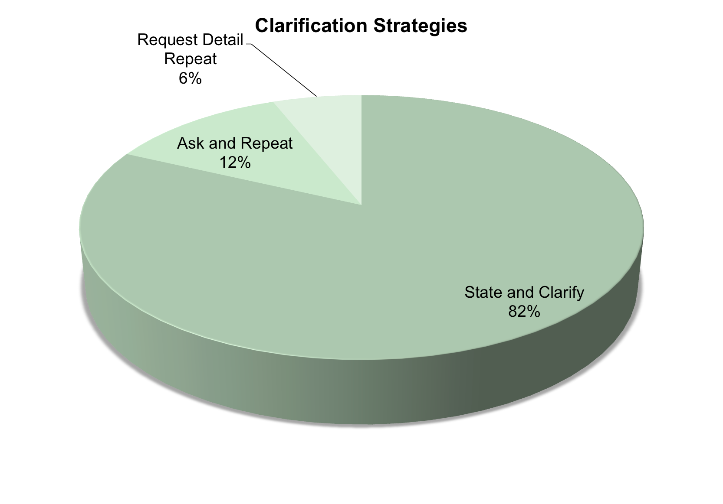
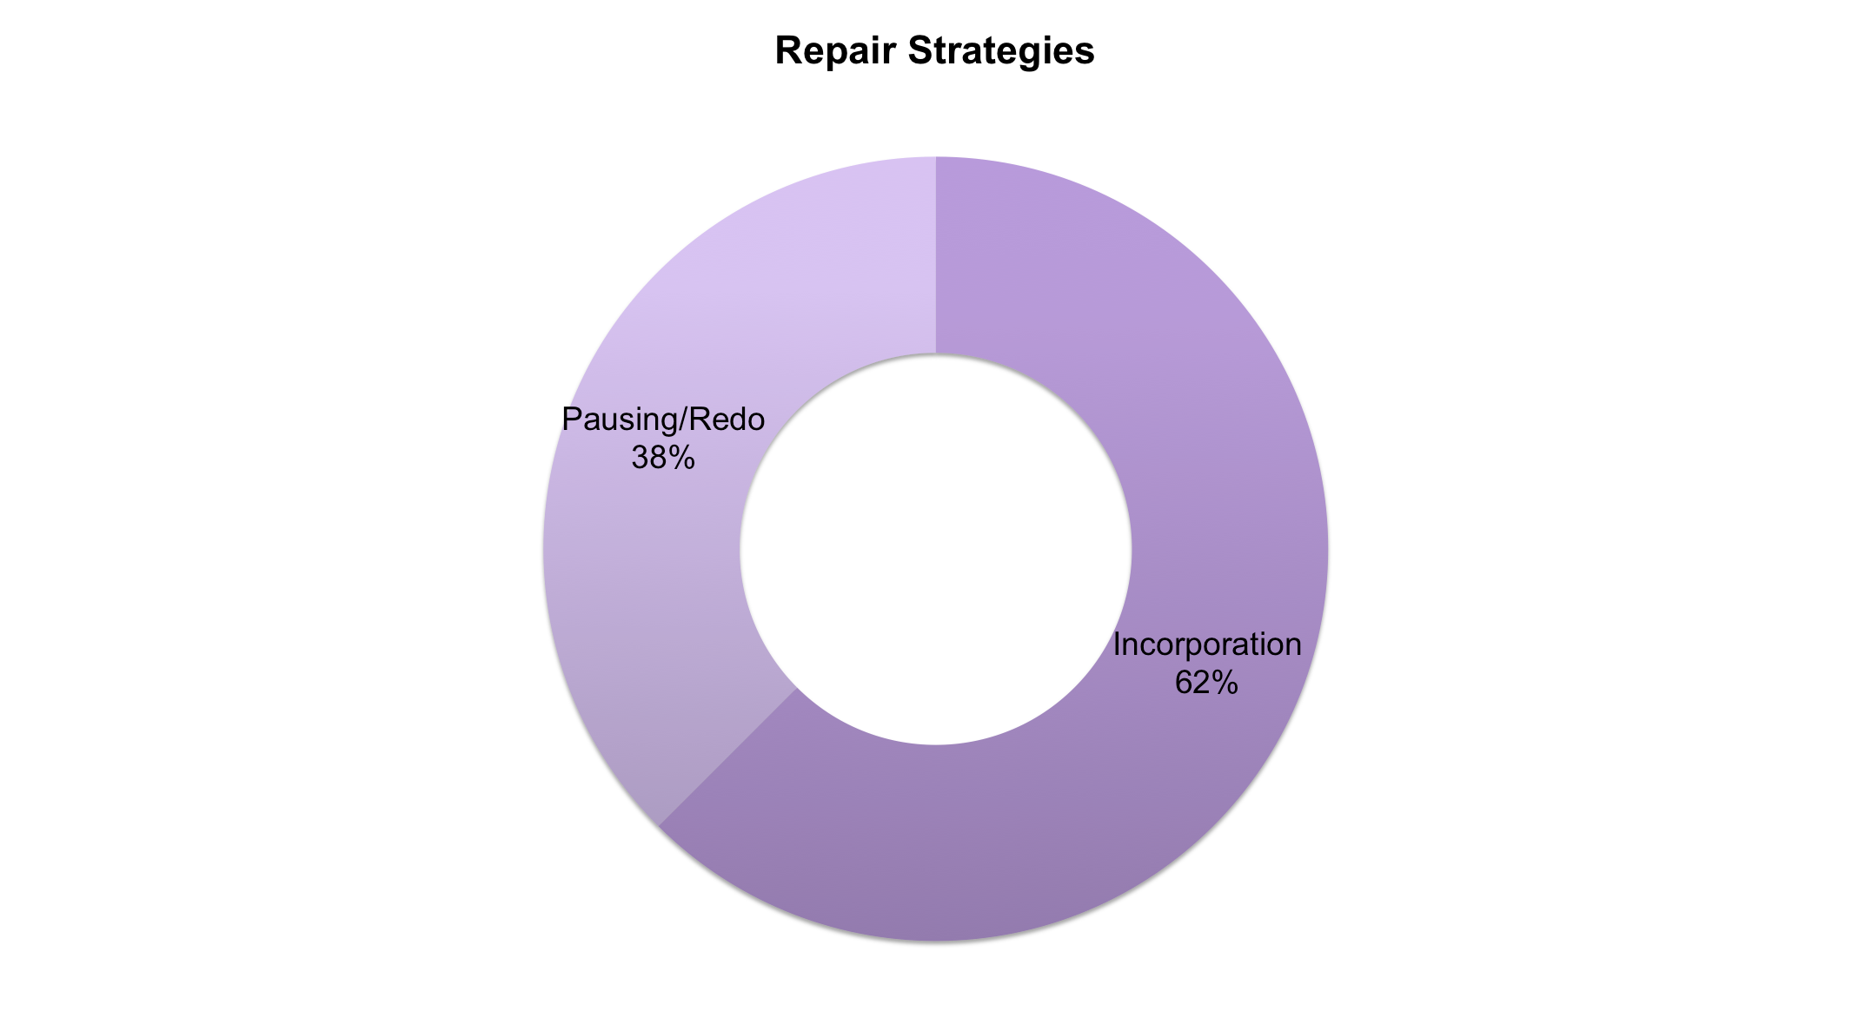
“An Investigation of Repair and Clarification Strategies used within Deaf/ Hearing Teams in Legal Settings”
By Courtney Nimersheim
Abstract
Methods Conclusion
Results
Due to the humanistic factor of interpreting, and the uniquely complex role the interpreters play working between languages, mistakes do happen. The key to a successful interpretation is knowing how to handle these mistakes by requesting clarification and repairing what may have already been misinterpreted to ensure the accuracy of the message. This study has investigated how interpreters working together in the legal setting choose to request the necessary clarification and how they correct their interpretation errors.
The results show “State and Clarify” to be the method used most frequently when clarifying the message content and “Incorporation” the strategy most often used for repairing the interpretation. This research needs to be conducted in effort to showcase what factors affect the interpreter’s decision-making process, seeking to discover why an interpreter will select a particular strategy over another.
Uncovering the reasons why
interpreters make the decisions they do, could impact the quality and approach of how we are training and teaching new interpreters.
Data available on the DVD series of Highly Effective Court Interpreting Teams in Action! created and dispersed by University of Northern Colorado Mid-America Regional Interpreter Education (UNC-Marie) was selected to be analyzed. The disc selected titled “Guardian ad Litem and Deaf Child Meeting” contains a Deaf child meeting with the court appointed official to discuss questions and concerns related to the divorce the child’s parents are going through.
Objectives
Clarification Strategies
 | Request Detail Repeat (number of instances) |  | Ask Repeat (number of instances) |  | State & Clarify (number of instances)
Video #1 |  |  | 1 |  | 8
Video #2 | 1 |  | 3 |  | 9
Video #3 | 1 |  |  |  | 10
Repair Strategies
 |  | Incorporation (number of instances) |  | Pausing/Redo (number of instances)
Video!#1 |  | 1 |  | 1
Video!#2 |  | 1 |  | 0
Video!#3 |  | 3 |  | 2
References
By looking at what methods interpreters are currently utilizing to clarify and repair their interpretations, this research seeks to understand:
. What strategies are currently being implemented
. If there are specific strategies that are used more often or more successfully than others.
Boinis, Mickelson, G., Gordon, Krouse, & Swabey. (n.d.). The Interpreting Process: Introduction and Skills Practice. 73-93.
Consecutive and Simultaneous interpreting. (2005). In T. Janzen (Ed.), Topics in signed language interpreting theory and practice (pp. 135-164).
Amsterdam: J. Benjamins Pub.
Highly Effective Court Interpreting Teams in Action! Series [Motion picture]. (2014). UNC-MARIE. Mathers, C. (2009). The Deaf Interpreter In Court:
!
An Accommodation That Is More Than Reasonable. Miller, V., & Matthews, C. (n.d.). Repairs in American Sign Language Interpreting: Interpreting
Strategies and Frequencies in Interpretations from English to American Sign Language.
Wilcox, P. (n.d.). Dual Interpretation and Discourse Effectiveness in Legal Settings.

