Slide 1
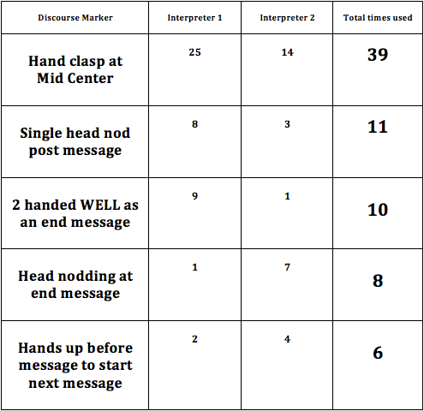
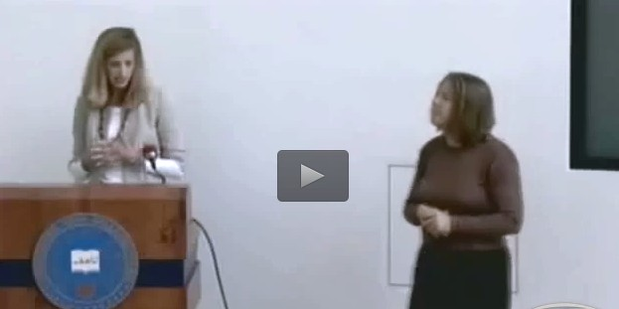
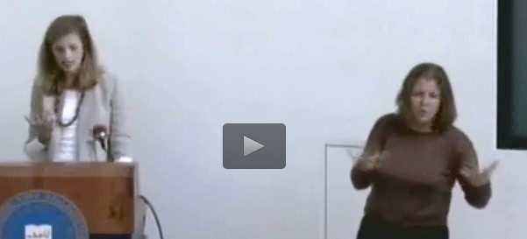
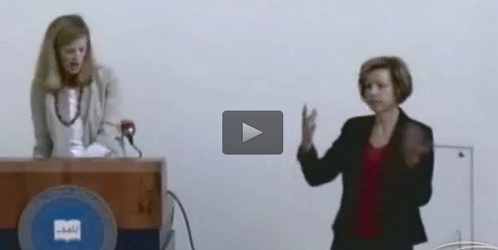
PlaDorm SeEngs: Top 5 Discourse Markers Used in English to ASL InterpreLng
By Lola Phan
INT 492 SPRING 2016
INTRODUCTION
RESULTS
DISCUSSION
CONCLUSION
v Hoza (2011), Schiffrin (1987), Metzger
& Bahan (2001): Discourse markers (DM) serve to provide cohesion as they link messages and thoughts together as well and indicate transition and shift in discourse.
v Results possible to be consistent and unique to setting.
² Platform setting: Monologue v.
Interactive
v The hands clasped at mid center and 2 handed WELL at the end of the message acts as
² WELL as explained by Hoza
² Politeness Function as explained by Hoza.
v Possible: Single head nod post- message can be commonly used DM tied to platform interpreting.
² Due to amount of information being given
v Head nodding at end of a thought or message as found in formal narratives (Valli, et al.).
² Reverse back channeling.
v The hands up message to start
² Turn taking indicator in a conversation. (Valli, et al.) Single speaker: Call for further attention
² Interactive: To take lead in conversation; Used in widespread conversation, not commonly tied to Platform Setting
v Top Five DM Used:
Hands clasp together at mid center (39 times)
Single head nod post message (11 times)
2 handed WELL to end a message (10 times)
Head nodding at end of message (8 times)
Hands up before next utterance is to begin (6 times)
v These discourse markers could be associated and likely found in platform and formal settings.
v Research could be used for understanding and teaching roles and usage for various DM in platform settings.
v Schiffrin (1987): DM come in the form of manual and non-manual markers, and spatial. DM can occur simultaneously.
DM Rule: When DM is removed message can still remain in tact.
EXAMPLES
v Humphrey & Alcorn (1998): Platform settings have a unique approach.
² More formal in nature, requiring formal register and discourse.
² Monolingual v. Interactive
HAND CLASP AT CENTER
(39)
METHODOLOGY & DATA COLLECTION
. Video used: Gallaudet’s Video Library, Linguistic Human Rights and the Future of ASL: Dr. Kendall King.
. The presentation is divided between 2 interpreters. Observations recorded for first 15 minutes of each interpreter for total of 30 minutes. Focus of tallies for discourse markers is collective between two interpreters.
. Data collection: Identified ASL discourse markers used in interpretations from each interpreter and any subsequent usage of ones already identified began a count. Top 5 are shown and discussed.
RESEARCH POSTER PRESENTATION DESIGN © 2015
www.PosterPresentations.com
§ RECOMMENDATIONS
Identify more DM in ASL, Common DM identified in other settings, Which register uses the most DM?
WELL at end of message
(10)
REFERENCES
• Hoza, J. (2011). The Discourse and Politeness Functions of WELL and HEY in American Sign Language. In Discourse in Signed Languages. Washington, DC: Gallaudet University Press.
• Humphrey, J. H., & Alcorn, B. J. (1998). So you want to be an interpreter? An Introduction to Sign Language Interpreting. Amarillo, TX: H & H.
• Metzger, M. & B. Bahan (2001). Chapter 5: Discourse Analysis. In (Ed.), The Sociolinguists of Signed Languages (pp. 131-133). New York, NY: Cambridge University Press
• Roy, C. B. (2000). Interpreting as a Discourse Process. New York: Oxford University Press.
• Schiffrin, D. (1987). Discourse Markers. Cambridge: Cambridge University Press.
• Valli, C., Lucas, C., & Mulrooney, K. J. (2011). Linguistics of American Sign Language: An Introduction (M. Villanueva, Ed.). Washington, D.C.: Clerc Books.
• Linguistic Human Rights and the Future of Sign Language – Dr. Kendall King. (2008, October 24). Retrieved from http://videocatalog.gallaudet.edu/?video=4539
LIMITATIONS
Additional videos could have been analyzed, specialized platform interpreters could have been specifically sought out, lack of research on other ASL DM.
HANDS UP before message
(6)

