Slide 1
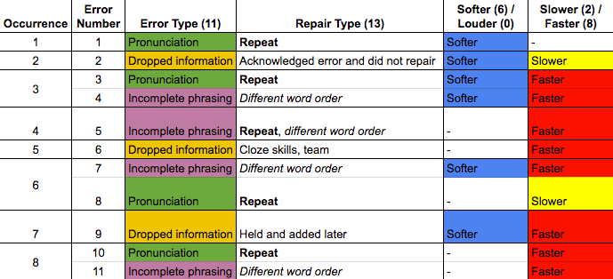
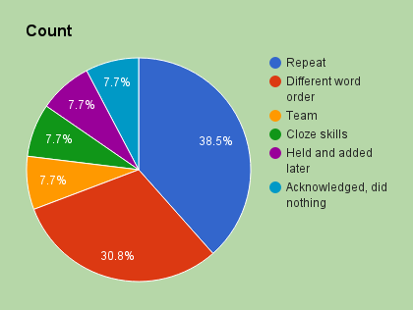
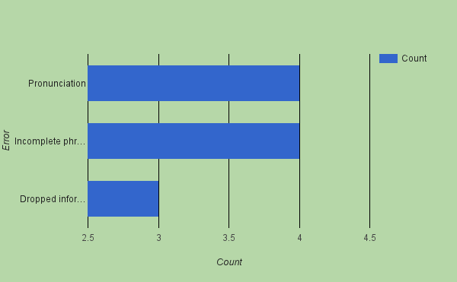
Types of Repairs Used During ASL-to-English Voiced Interpretations
Lucas King
INT 492 - Spring 2016
Introduction Methodology & Data Collection Discussion
This study focused on the various types of repairs used by interpreters when interpreting from American Sign Language into spoken English. It will answer the question that asks which techniques are most often employed when voicing an interpretation into English.
The YouTube video from Gallaudet University’s sesquicentennial celebration was selected as it has substantial length, moderate linguistic complexity, and ample opportunities for interpreters to utilize repair strategies. All collected data, including whether or not there was a change in volume and/or speed, was color-coded and condensed to identify patterns based on error type, repair type, volume, and/or speed. A total of eleven examples of repairs were identiﬁed.
Any time that the interpreter stuttered or pronounced a word incorrectly, she stopped and repeated the word or phrase correctly. She very well could have used another word if, perhaps, she was struggling with the speciﬁc word or phrase as sometimes happens when people become tongue-tied. This seems to say that it is easier to go back and correct the pronunciation of a word already decided upon instead of using more energy to ﬁnd a new or diﬀerent word that may be easier to pronounce.
Findings
Literature Review
Cokely (1992) identiﬁed and deﬁned ﬁve signiﬁcant types of errors and miscues that caused deviations from the original message:
Conclusion & Recommendations
Future studies could examine both men and women as well as interpreters of diﬀerent cultural and ethnic backgrounds. However, the data collected from this research can show that there are deﬁnite trends among the various types of interpreting repairs.
Omissions
Additions
Substitutions
Intrusions
Anomalies
References
Morgan (2008) mentioned various approaches as to how interpreters can make their repairs to a message when interpreting into English. A few examples are
Cokely, D. (1992). Interpretation: A sociolinguistic model. Linstok Press.
Matthews, C., Miller, V. (2012). Repairs in American Sign Language Interpreting: Repair Strategies and Frequencies in Interpretations from English to American Sign Language. Northeastern University.
Morgan, E. F. (2008). Interpreters, conversational style, and gender at work. Deaf professionals and designated interpreters: A new paradigm, 66-80.
Ressler, C. I. (1998). A comparative analysis of a direct interpretation and an intermediary interpretation in American Sign Language. Gallaudet Press.
Sesquicentennial Lecture Series: Ritchie Bryant - March 6, 2014. (2014, May 21). Retrieved from https://youtu.be/3oVJ0b1cd0Y.
Van Besien, F., & Meuleman, C. (2004). Dealing with speakers’ errors and speakers’ repairs in simultaneous interpretation: a corpus-based study. The Translator, 10(1), 59-81.
“The interpreter needs to rephrase that…”
“Said diﬀerently…”
“A better way to state that is…”.

