Slide 1
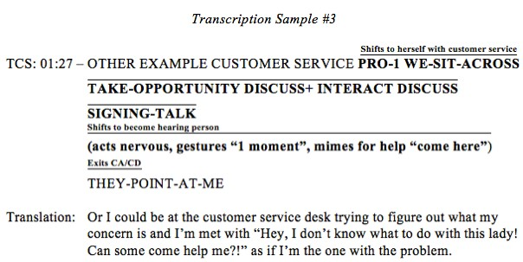
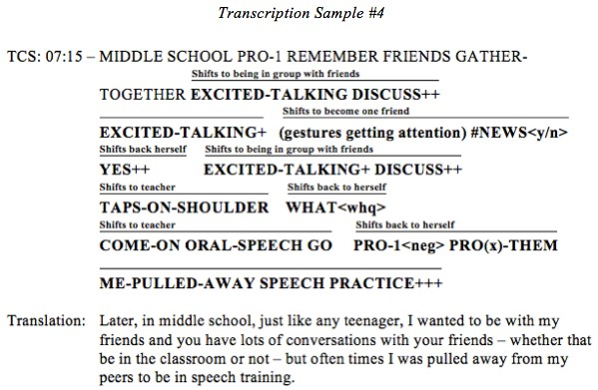
Background
Conclusion
The findings of this research indicate that prepared/rehearsed translations most often restructure CA and CD in English to become indirect, reported action typically from the speaker’s perspective.
It was the aim of this research analysis to bring more light to the lack of information the field of ASL/English interpretation has regarding the use of the features. Armed with more knowledge in how interpreters currently work with the features in various settings, the field could seize the opportunity to make adjustments to their approaches whether in practice or in education. If interpreters were to become more skilled at handling constructed action and constructed dialogue, it would, in theory, require less processing which would mitigate fatigue and miscues. To that end, the consumers (both hearing and Deaf) would benefit from the increased accuracy of culturally-appropriate interpretations and translation work.
Constructed action and constructed dialogue are frequently-used features of discourse in American Sign Language. Due to the high level of visuospatial orientation that accompanies these features, interpreters and translators have often struggled to seamlessly incorporate the utterances into spoken or written English without source language intrusions. The question at hand, then, is how do interpreters work with CA and CD from ASL currently?
If the field of ASL/English interpretation can learn the current patterns of how the features affect interpretations and translations alike, then professionals and educators can adapt their current approaches to best manage occurrences of CA and CD in their work. This would, inevitably, lead to improved interpretations and translations which would have direct, positive impacts on consumers of interpretation and translation services.
Results
Discussion
• Five transcription samples were selected to be shown.
Methodology
• 19/21 transcriptions show that the prepared English translation restructured CA/CD as indirect, reported action in the first-person and plural second-person perspectives.
References
• A 17-minute recorded TEDx lecture given by Marika Kovacs-Houlihan at the University of Wisconsin-Milwaukee was analyzed for the use of CA/CD in ASL.
Braga, T. & Talbot, E. (2009). Constructed action and constructed dialogue and lexical variation in black ASL. Retrieved from http:// www.gerardwilliams.net/docs/Braga-Talbot%202009.pdf
• Further support of prior research was noted.
Roy (1989) found that CA was used more frequently than CD in lecture-based discourse. Metzger (1995) proposed that CA/CD can not only co-occur, but that CD is a form of CA.
Limitations & Suggestions
• Raw data with identifying information is scarce.
Johnstone, B. (1986). Arguments with Khomeni: rhetorical situation persuasive style in cross-cultural perspective. Text, 6:171-187. Retrieved from http://works.bepress.com/barbara_johnstone/40/
• All uses of CA/CD were transcribed using a computer-based program called ELAN and subsequently transposed into a Word document using semi-standard glossing methods.
Kovacs-Houlihan, M. (2015, November 10). Deaf ideology. [Video File]. Retrieved from https://www.youtube.com/watch?v=pLBw9nYI_Ks
Metzger, M. (1995). Constructed Dialogue and Constructed Action in American Sign Language. In Ceil Lucas (ed.) The Sociolinguistics of the Deaf Community. San Diego; Academic Press.
• Instances of CA/CD were grouped into a single transcription based on the presenter’s initiation and completion of a concept as well as when she returned to standard, monologic discourse.
Roy, C. (1989). Features of Discourse in an American Sign Language Lecture. In Ceil Lucas (ed.) The Sociolinguistics of the Deaf Community. San Diego; Academic Press.
• No Institutional Review Board approval.
• Future studies should obtain samples of various translations by increasing the sample size and consider applying the research methods to simultaneous interpretations.
Tannen, D. (1989). Talking voices, repetition, dialogue, and imagery in conversational discourse. Cambridge; Cambridge University Press.
• A total of 21 transcriptions were created and analyzed to find any patterns in how utterances of CA/CD are conveyed in idiomatic English.
Thumann, M. (2011). Identifying depiction: Constructed action and constructed dialogue in ASL presentations. In C.B. Roy (Ed.) Discourse in signed languages (Vol. 17, pp. 46-66). Washington, DC: Gallaudet University Press.

