Slide 1
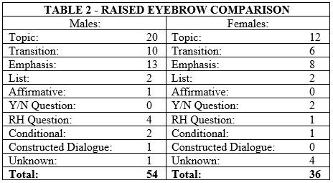
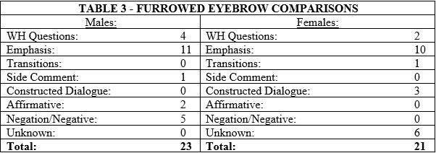
A Gender Comparison of Non-­‐Manual Eyebrow Usage During Platform Interpreting
By Savannah Hiatt
INT 492, Spring 2017
Introduction
Females are said to be more expressive than males.
Both raised and furrowed eyebrows used by male and female interpreters were looked at, compared, and analyzed.
Research Question
Do female interpreters use more non-­‐ manual eyebrow markers than male interpreters?
Discussion
Male interpreters used more eyebrow non-manual markers than female interpreters.
Findings
In every category, except for List which was equal, male interpreters had higher numbers.
Female interpreters had more Unknown reasons for eyebrow raises and furrows.
Literature Review
The more English signing interpreting had less non-manual markers.
-­‐Discusses different categories of ASL sentence types and eyebrow non-­‐manual markers. (Valli, et. al., 2011)
Limitations & Recommendations:
Unknown background of interpreters if they are native ASL users or L2 users. Knowing would help to understand if it is a gender difference or a background difference.
-­‐The difference in male and females facial expressions while showing emotions. (Huang, 2009)
-­‐ Females tend to have stronger facial expressions than men. (Fischer & LaFrance, 2015)
Methodology
Short time frame analyzed in the beginning, meaning interpreters have not really “warmed up” yet.
5 videos were chosen from a platform setting
6 interpreters – 3 males and 3 females.
3 minutes and 15 seconds analyzed of each interpreter.
10 eyebrow raises subcategories, 8 eyebrow furrow subcategories were identified and coded.
Comparing eyebrow non-manual markers between English transliterations and ASL interpretations.
Conclusion:
According to the research, female interpreters do not use more non- manual eyebrow markers than male interpreters in a platform setting.
RESEARCH POSTER PRESENTATION DESIGN © 2015
www.PosterPresentations.com

