Slide 1
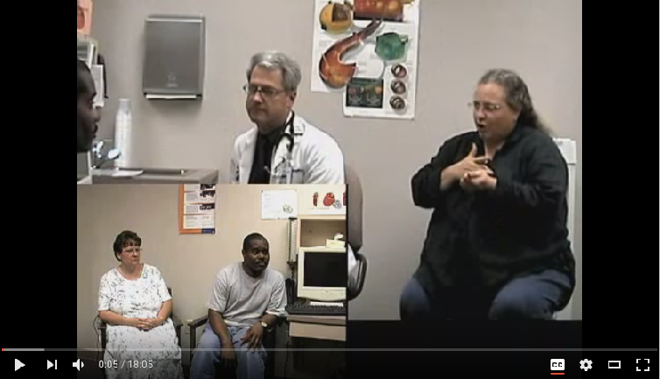
Interpreting Strategies: Medical Terminology from English to American Sign Language
INT 492, Spring 2017
by India Hitchcock
Introduction
Many deaf people rely on interpreters when communicating with their healthcare providers. But what strategies do American Sign Language/English interpreters use when translating complex medical terminology from English to ASL?
Literature Review
Results & Analysis
Limitations
This research was a very small scale pilot study. Some limitations include:
One researcher
One deaf consumer
One topic
One interpreter
Very few categories of medical terms
Effectiveness was not measured
ASL/English interpreting research and literature is underwhelming, particularly for healthcare interpreting. Two gaps within this field include the lack of research-based publications, and the absence of specific recommendations for interpreters regarding the linguistic choices they have to make when faced with complex medical terminology in English.
Almost exactly two thirds of the nouns were interpreted into ASL using fingerspelling. Less commonly referenced anatomical words, for example “vein,” “artery,” and “aorta,” were fingerspelled, while more body words like “heart,” “muscle,” and “stomach,” were signed. There were two instances of medical terms in English being only partially fingerspelled when interpreted in ASL. These English terms were “angina pectoris,” translated only as “angina,” and “nitroglycerin,” translated as “nitro.” There was one instance of depiction indicating a medication.
Recommendations & Conclusions
This study indicates that by far the most prevalent strategy for complex medical terms interpreted from ASL into English is fingerspelling. Future research on this topic should be much larger in scope.
Other potential medical jargon categories to be studied include medical procedures, treatments, medical equipment, medical professionals, trauma events, and indicating pain levels, as well as types of pain. An examination of accuracy or effectiveness would also be beneficial.
References
Data Collection
The researcher analyzed one 18-minute video clip of a cardiac consultation between a doctor and a Deaf patient. The ASL translations of English nouns were coded three possible ways, 1) as a single ASL sign, 2) fingerspelled, 3) depicted.
The English terms coded were limited to anatomical terms, conditions, and medication. Repetition was not excluded.
Discussion & Findings
Dean, R. K., et al, (2003). Training medically qualified interpreters. RID Views,20,2.
This research has generated an incomplete list of strategies interpreters use when interpreting medical terms from English to ASL. This research does seem to indicate that fingerspelling is by far the most common strategy used when interpreting proper nouns from English to ASL in a medical setting. A deeper investigation of fingerspelling may be educational. Fingerspelling in this video ranged from very clear and measured to much more efficient - even to the point of missing letters. A look into “sandwiching,” that is the use of multiple interpreting strategies consecutively, could also be done. There were two instances within this video of a noun being interpreted using both fingerspelled and another strategy.
deVleming, R. (1999, March). The medical interpreter: An integral part of the health care team. RID Views, 16, 14-15.
Dower, C. (2003). Health care interpreters in California. San Fransisco: UCSF Center for the Health Professionals.
Goldberg, R. (2003, January). Building your medical vocabulary: Some practical suggestions that don’t involve going to medical school (sort of). RID Views, 20, 6-7.
Swabey, L., et al. (2014). An examination of medical interview questions rendered in american sign language by Deaf physicians and interpreters. investigations in healthcare interpreting, 104-127.
Yaffe, H. (1999, March). The specialty of medical interpreting. RID Views, 16, 1, 12.

