Slide 1
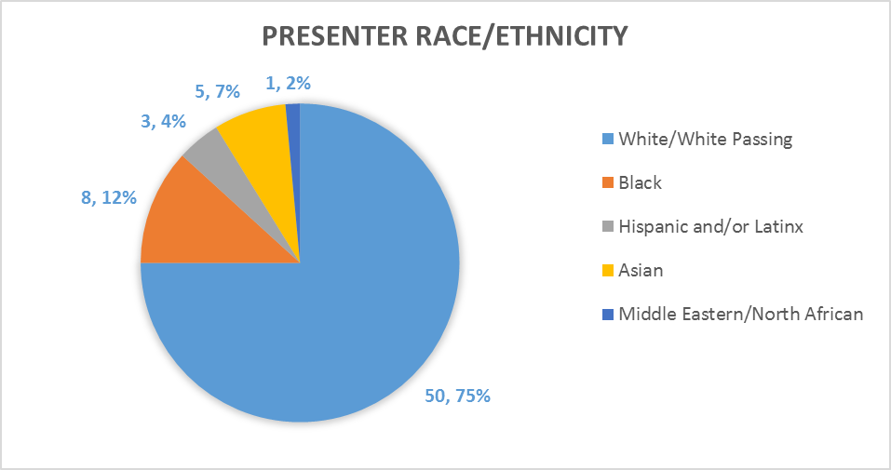
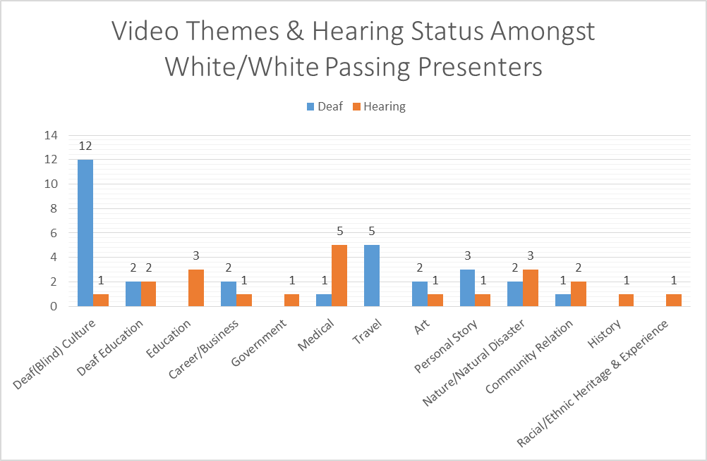
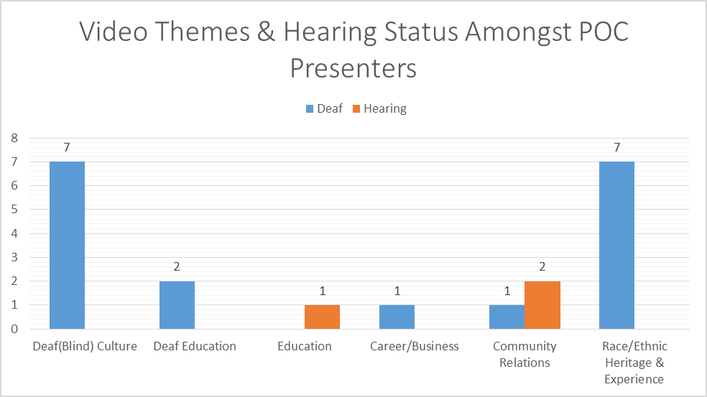
Is There Anyone That Speaks Like Me? An Analysis of Video Text Made for Interpreter Education Programs and the Inclusion of People of Color
Rodney Lebon INT 492, Spring 2017
Introduction
There is a lack of representation of People of Color (POC) and diverse language use in Interpreter Education Programs (IEP), specifically in curricular material such as stimulus videos and sample text. Research has shown the need for exposure and inclusion of diverse language use and a multicultural framework in IEPs, yet, an examination of what exist already in our material is needed?
Literature Review
Findings & Discussion
Ø➢ Figure 1 shows the majority of presenters (75%) were White/White Passing. Of the POC group the largest group was Black (12%), followed by Asian/Asian American (7%), Hispanic and/or Latinx (4%), and Middle Eastern/North African (2%). Ø➢ Figure 5 shows low number of hearing POC (3;4%) presenters represented in the series in limited themes (2;15%) compared to the hearing White/White Passing (22;30%) represented in all 12 out of 13 (92%) themes as seen in Figure 4. Ø➢ Deaf POC were more likely to have dual video themes paired with Racial/Ethnic Heritage and Experience which highlights the importance of adopting a multicultural interpreting model which recognizes the intersectionality (Lightfoot, 2007; West Oyedele, 2015). Ø➢ Not only are few POC represented across video themes, even less POC Deaf discuss professional matters when contrasted with W/WP Deaf or hearing presenters. Could this reflect the value seen of communities of color, their capabilities? Does this system continually oppress POC communities?
Conclusion & Recommendations
This study showed that POC are underrepresented in video text created for interpreter education. Factors may included value perceptions of features commonly present in minority language use, especially in academia, and outsourcing efforts. Recognizing the racial or ethnic heritage of students and their linguistic backgrounds benefits the student, the Deaf and interpreting communities, and other stakeholders. Interpreter educators have the responsibility of actively invite and involve POC into their classrooms via live interaction or video text (West Oyedele, 2015; NIEC, 2016). Communities of color should assist in creating material that appropriately represent them across multiple themes (Shambourger, 2015). White colleagues and predominantly white institutions, are encouraged to recognize the importance of becoming involved with and being exposed to communities of color (Shambourger, 2015).
Ø➢ Bruce (1998) discussed the lived experience of Deaf and non-­‐Deaf Black/African American people having to live in two worlds: their own Black/African American community to stay “hip” or current and also the White community for the purposes of mobility and success.
Ø➢ West Oyedele’s (2015) survey showed that 445 of 662 Black/African American interpreters felt cultural competence was lacking in their IEP and among colleagues.
Ø➢ Of the 24 nationally certified interpreters who interpreted a video source that contained Black ASL, 41% of whom were Interpreters of Color, only one interpreter used African American English for an utterance in their interpretation of the text (Shambourger, 2015).
Ø➢ National Interpreter Education Center (2016) reported “Several [interpreters] described their IEP experience as ‘white, hearing students being taught about white, d/Deaf people by white, hearing instructors.” Some students reported that they were criticized for their English and/or signing as being inappropriate or too expressive.
Figure 1. Presenter Race/Ethnicity.
Figure 4. Video Themes & Hearing Status amongst White/White Passing Presenters.
Methodology
Analysis of the TerpTalks series, a video library of 65 videos provided through the National Consortium of Interpreter Education Centers. . The videos simulate the broad discourse style and content that an interpreter who works in the community may be expose.
Figure 5. Video Themes & Hearing Status amongst POC Presenters.
Acknowledgement
References
Bruce, J. (1998). Assisting African American/Black ASL/IPP Students Navigate Between Learning in the Classroom and Learning Outside the Classroom. The Keys to Highly Effective Interpreter Training: Proceedings of the Twelfth National Convention (pp. 1-­‐18). Salt Lake City, UT: Conference of Interpreter Trainers. Retrieved from http://gaislandora.wrlc.org/islandora/object/cit%3A7/datastream/PDF/view
Lightfoot, M.H. (2007). Interpreting Culturally Sensitive Information in VRS Settings. Retrieved from http://www.interpretereducation.org/wp-­‐content/uploads/2011/06/0607_cultural_diversity1.pdf National Consortium of Interpreter Education Centers. (2016). Retrieved February 13, 2016 from http://www.interpretereducation.org/
National Interpreter Education Center. (2016). Understanding the Challenges of Interpreters of Color: Needs Assessment Report. Retrieved from http://www.interpretereducation.org/wp-­‐ content/uploads/2014/02/Final-­‐Interpreters-­‐of-­‐Color-­‐FG-­‐Report-­‐12-­‐16.pdf
Shambourger, N. (2015). Navigating Language Variety: ASL/English Interpreters “Giving Voice” to African American/Black Deaf Signed Language Users. (Master’s Thesis). Retrieved from http://digitalcommons.wou.edu/cgi/viewcontent.cgi?article=1026&context=theses
West Oyedele, E. (2015). Persistence of African-­‐American/Black Signed Language Interpreters in the United States: The Importance of Culture and Capital. (Master's Thesis). Retrieved from http://digitalcommons.wou.edu/theses/19
This research study would not have been done without the overwhelming support and guidance of several Deaf POC, Interpreters of Color, and our allies. Specifically I would to thank in no particular order Folami Ford, Mercedes Hunter, Su Kyong Isakson, Paris McTizic, Tyriibah Royal, Jo Linda Greenfield, Dr. Leandra Williams, Dr. Joseph Hill, MJ Jones, Casey McCarthy, and many more. Thank you for keeping me motivated.

