Slide 1
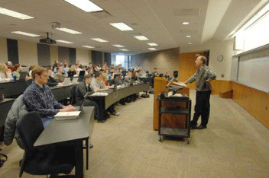
14

Slide 2
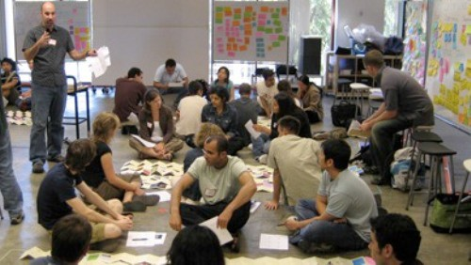
15

Slide 3

16

Slide 4

17

Slide 5
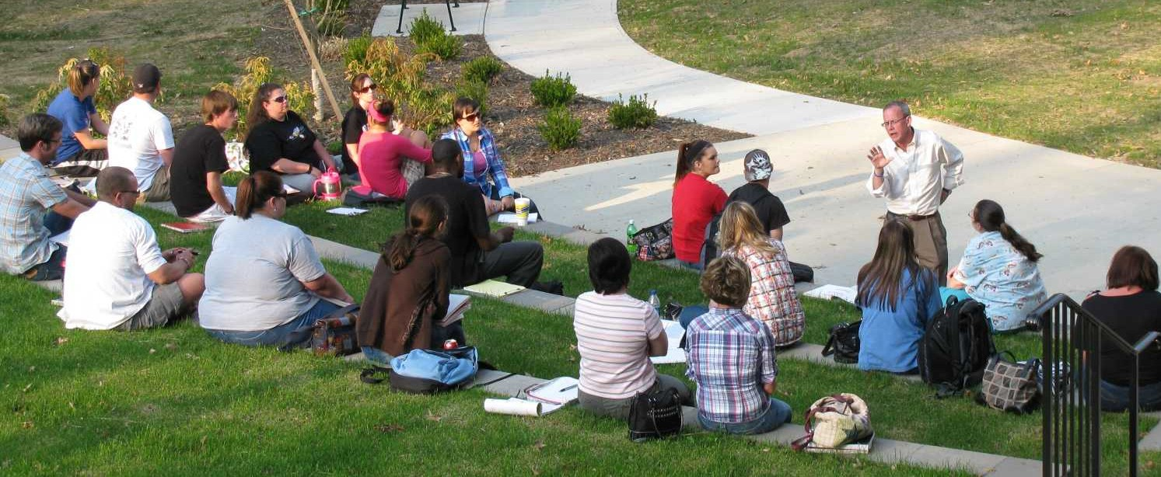
18

Slide 6
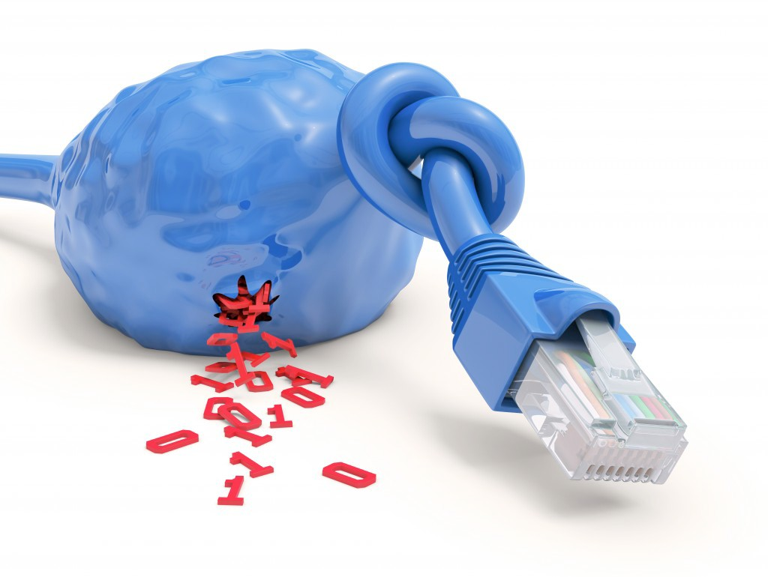
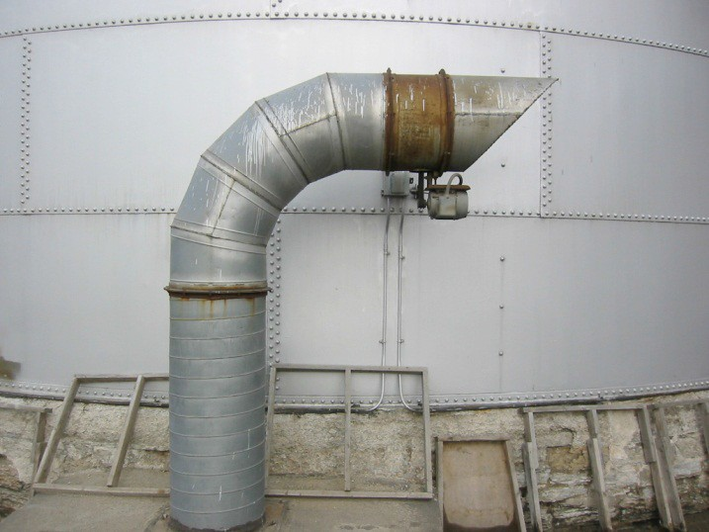
Big Pipes
Bandwidth
19

Slide 7

Course Variables
20

Slide 8

Course Format
21

Slide 9

Questions to ponder
1. Just because VRI is available, does that mean we should use it in postsecondary?

Slide 10
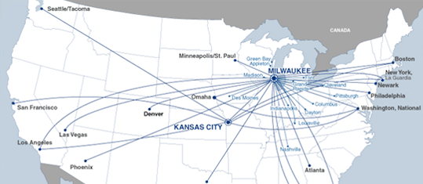
2.Can we/should we create a national network of postsecondary VRI?

Slide 11

3. Do you see pros and cons?

Slide 12

Details
Presentation document will be available online
Pepnet 2 has a live chat and listserv: h/p:// www.pepnet.org/reslistserv.php
Lisa Caringer will lead part 2 of the postsecondary VRI symposium
Contact info: bambi.riehl@pepnet.org
www.pepnet.org

Slide 13
26

