Slide 1
Postsecondary Video Remote Interpreting
National Symposium on Video Interpreting: The State of the Practice and Implications
Gallaudet University Regional Interpreter Educa7on Center
Lisa Caringer, Coordinator SIU Carbondale
Video Remote Interpreting Lcare@siu.edu

Slide 2
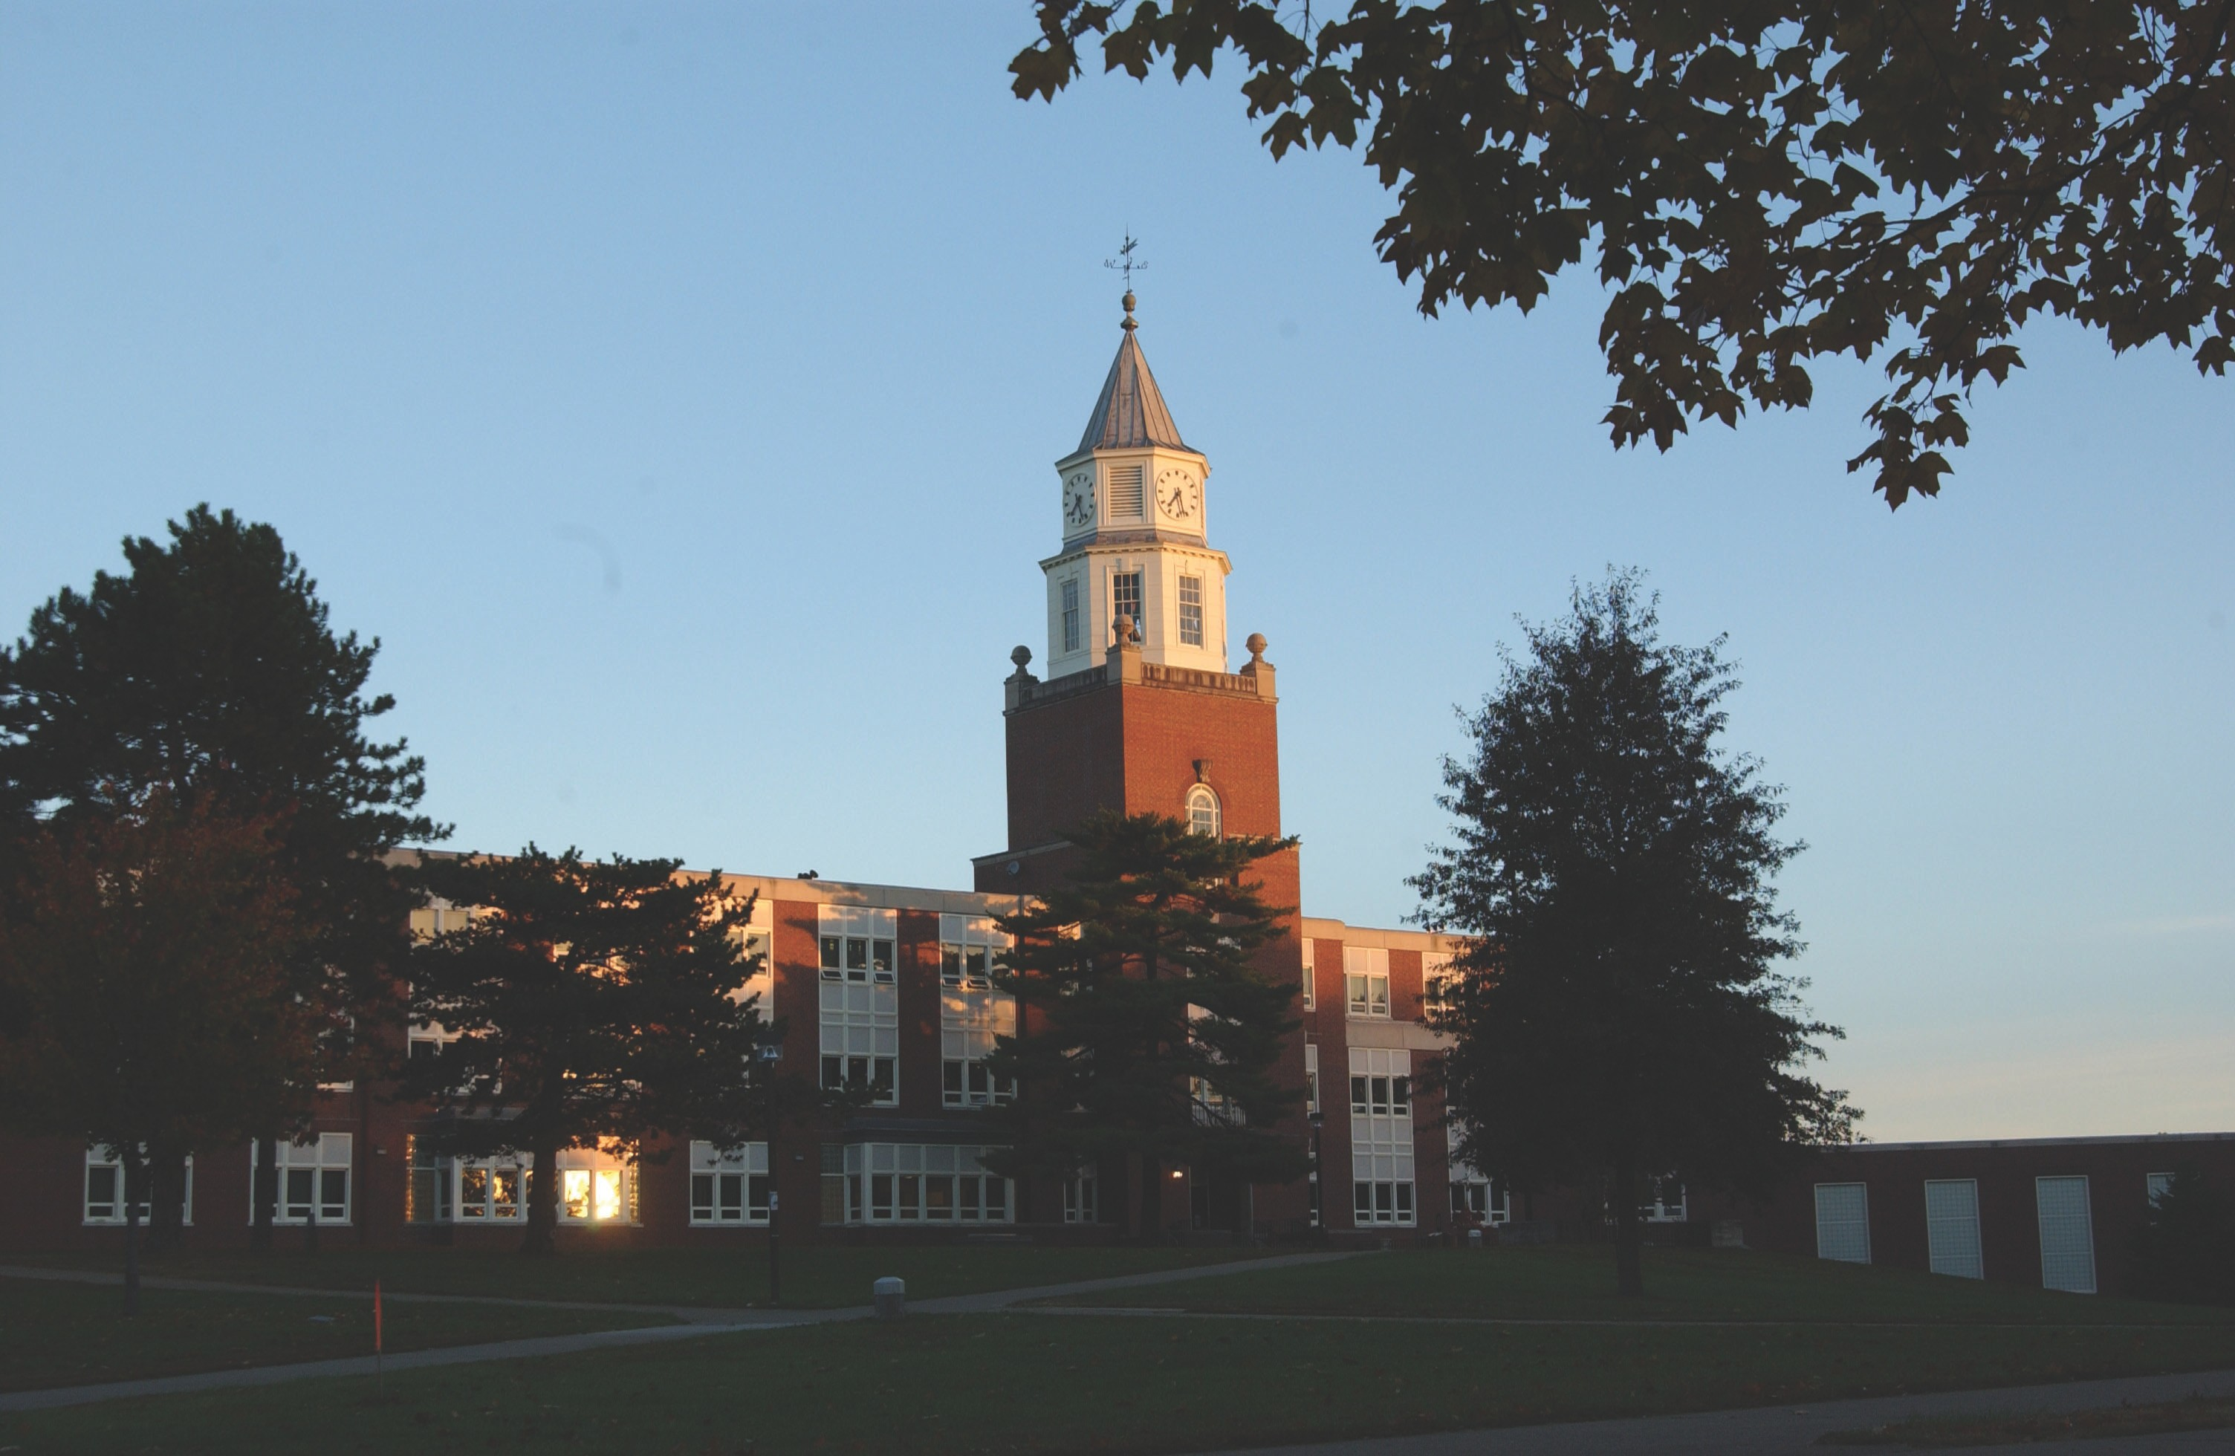
SIUC Program History and Opera6on

Slide 3
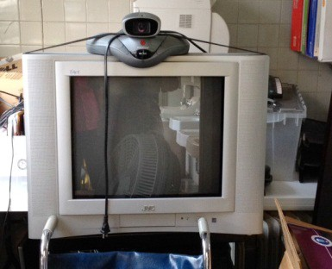
Equipment & SoBware
Traditional Equipment
Laptop with peripheral equipment
microphones a must in postsecondary environment
CMA and usability for students

Slide 4
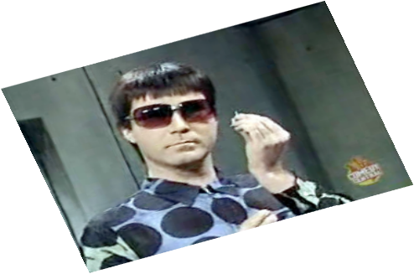
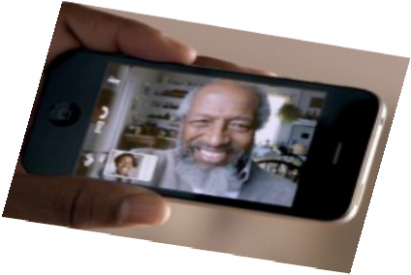
Equipment & SoBware
DOJ Regulations implementing ADAA Title II
•
Training a must, most especially for students using the plaMorm
Future Equipment
•
Tablet or IPad or other “web machine”
lightweight and portable, built for receiving video media over the web

Slide 5
Case Management & Student Characteris6cs
Coordinators use existing skills Eﬀective Communication
Based on individual student and course
Self Advocate Open to using VRI?
Maturity & Independence Training & Trouble shooting

Slide 6

Interpreter Standards
Qualiﬁed
Consistently Scheduled
Prepared

Slide 7
Questions
Should VRI agencies/interpreters assume the responsibility to help the student advocate for an on‐site interpreter when appropriate?
Is it misplacing the responsibility of the accommodation on the student to transport and set‐up the equipment rather than tech support to deliver it to each class?
Will use of tablet or IPad signiﬁcantly change how VRI is used in postsecondary environments?

