Slide 1
Analyze, Synthesize, and Criticize, oh my!: Check out our critical thinking toolkit!
Caroline Solomon
Professor, DSTM
Assessment Day Workshop
January 12, 2016

Slide 2
Before continue…a brief history……where did I learn this stuff I’m going to talk about today?

Slide 3
University of Maryland got NSF funding to set up a Science Learning Center called SESYNC (Social-Environmental Synthesis Center)
I got involved with their socio-environmental synthesis (SES) teaching study and co-taught two SES courses with Dr. Khadijat Rashid
Last summer, I attended a workshop at SESYNC in June along with Dr. Cara Gormally

Slide 4
Gallaudet University Student Learning Outcome 2: Critical Thinking
Students will summarize, synthesize, and critically analyze ideas from multiple sources in order to draw well-supported conclusions and solve problems.

Slide 5
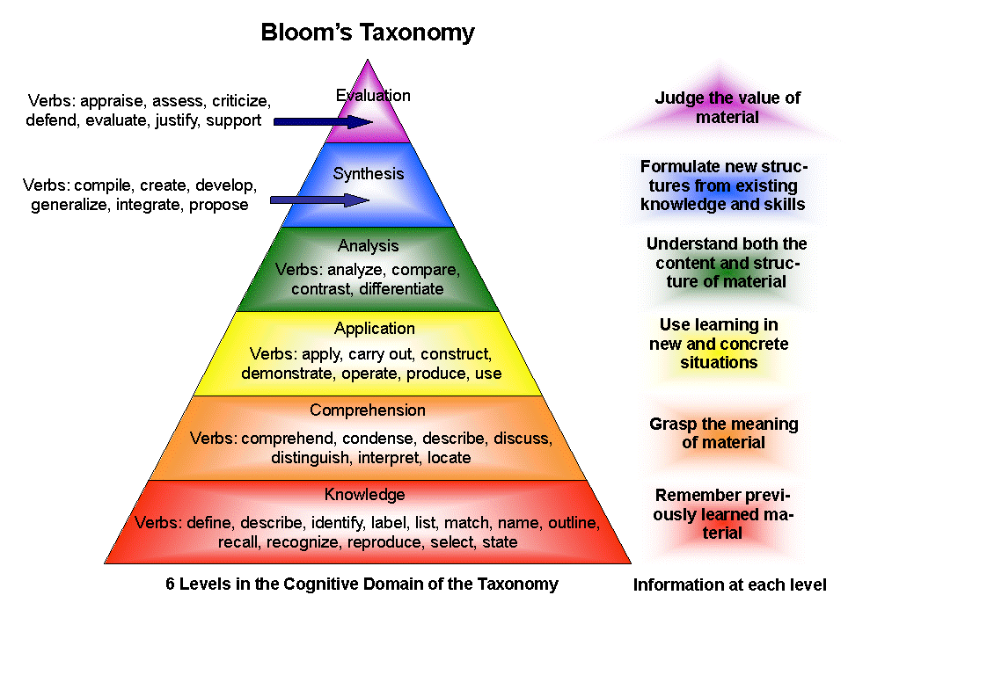
How do you get students here? And how do you assess that????

Slide 6
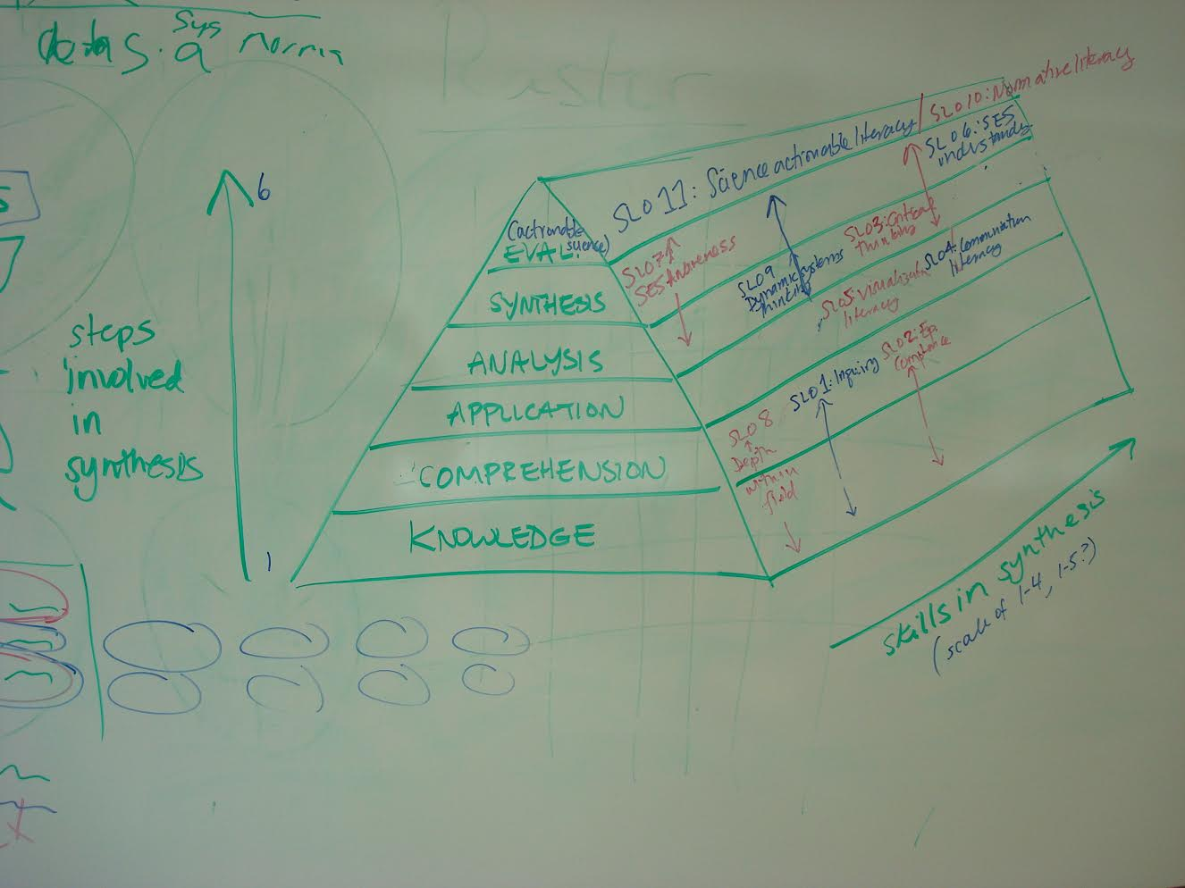

Slide 7
Let’s see what we already have in our toolkit to assess critical thinking from our own faculty and staff.
Please share your own experiences.

Slide 8
Let’s begin with a case study The Big Bad Wolf or Symbol of the American Wilderness?
There are many excellent resources to find case studies to encourage discussion that involves analysis, critical thinking and synthesis.
National Center for Case Study Teaching in Science : http://sciencecases.lib.buffalo.edu/cs/
International Journal of Teaching and Case Studies (http://www.inderscience.com/jhome.php?jcode=IJTCS)

Slide 9
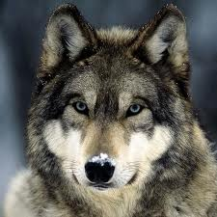
The Big Bad Wolf

Slide 10
Group assignments: 20 minutes
All of the groups will create concept/system maps based on the case study
Group 1: Draw the map by hand
Group 2: Use Mental Modeler
(program available via web)
Group 3: Use EcoModeler
(program available via web)

Slide 11
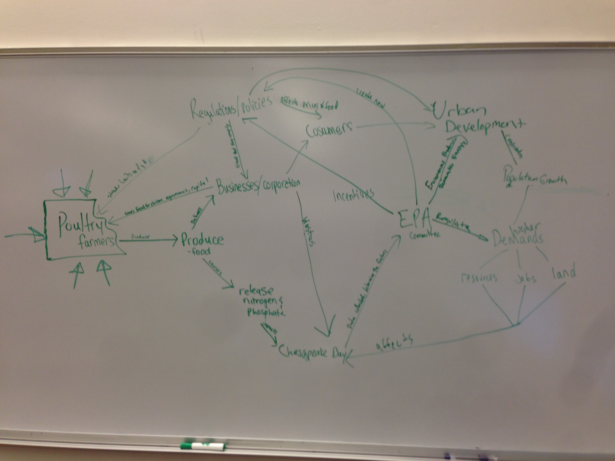
Examples of my own students concept/system maps

Slide 12
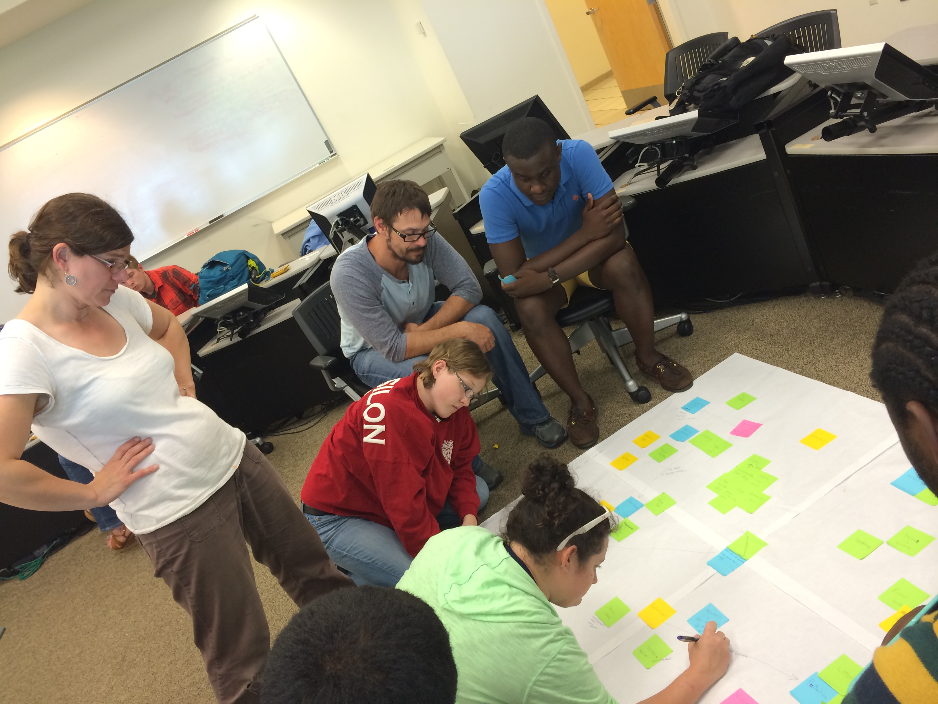
Examples of my own students concept/system maps

Slide 13
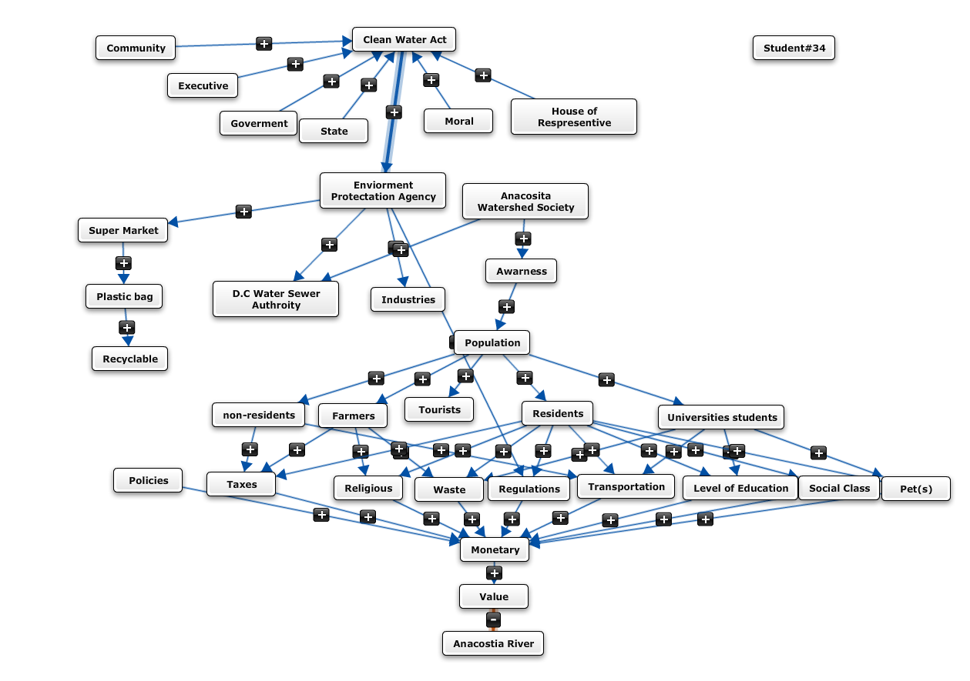
Examples of my own students concept/system maps

Slide 14
Group assignments: 20 minutes
All groups will now discuss HOW to assess the maps for analysis, critical thinking and synthesis skills by looking at another group’s map

Slide 15
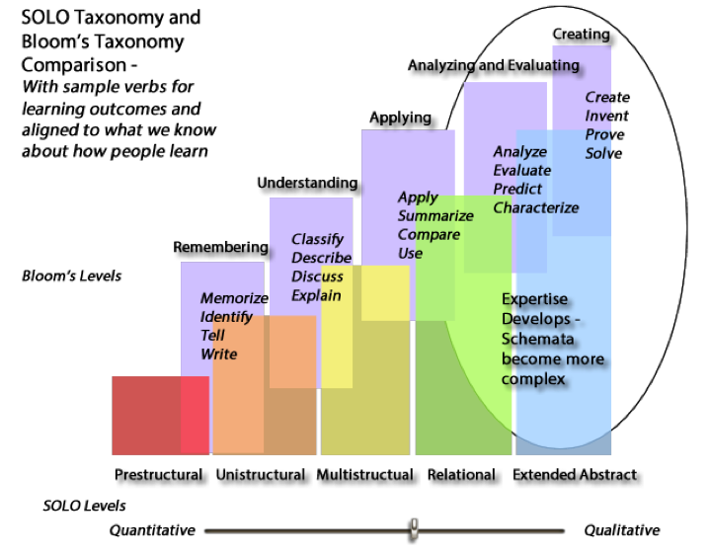
How other people have started to think about assessing concept maps: Structure of observed Learning Outcomes (SOLO) Taxonomy

Slide 16
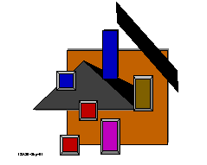
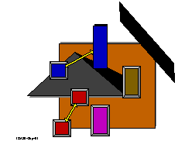
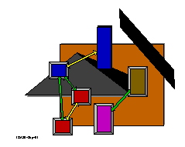
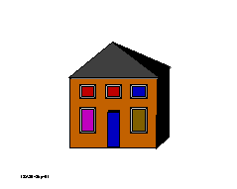
Unstructural
Unistructural
Mulitstructural
Relational
Extended abstract
From: http://www.learningandteaching.info/learning/solo.htm

Slide 17
Stewart, 2012

Slide 18
SOLO Taxonomy Level Descriptions of Student Response SOLO coding score
Stewart, 2012

Slide 19
Kinchin et al. 2000

Slide 20
Kinchin et al. 2000

Slide 21
Kinchin et al. 2000

Slide 22
SBF vs. PMC-E²
SBF = Structure-Behavior-Function
based on the idea that students will place structures on the concept/system map first
PMC-E² = Phenomenon-Mechanism-Components-Evidence-Explanation
based on the idea that students should be encouraged to begin with the phenomenon and that the E² provides a way for self-direct learning and express their ideas
Jordan et al. 2014

Slide 23
If time permits….

Slide 24
Individual or members of the same program/department assignments: 20 minutes
Now search for a case study that you would use in one of your courses (or one that you already use) and draw your own ‘expert’ map

Slide 25
Individual or members of the same program/department assignments: 10 minutes
Now use your ‘expert’ map as a guide to determine what you feel are the important elements of critical thinking that you would like your students to achieve (which would eventually be listed in an assessment rubric)

Slide 26
Different tools to use
One-Sentence Summary
Word Journal
Approximate Analogies
Concept Maps (discussed today)
Invented Dialogues
Annotated Portfolios
From Angelo, TA, Cross KP. (1993) Classroom Assessment Techniques: A Handbook for College Teachers. Second Edition. Jossey-Bass Publishers. San Francisco, CA.

Slide 27
Extra slides

Slide 29
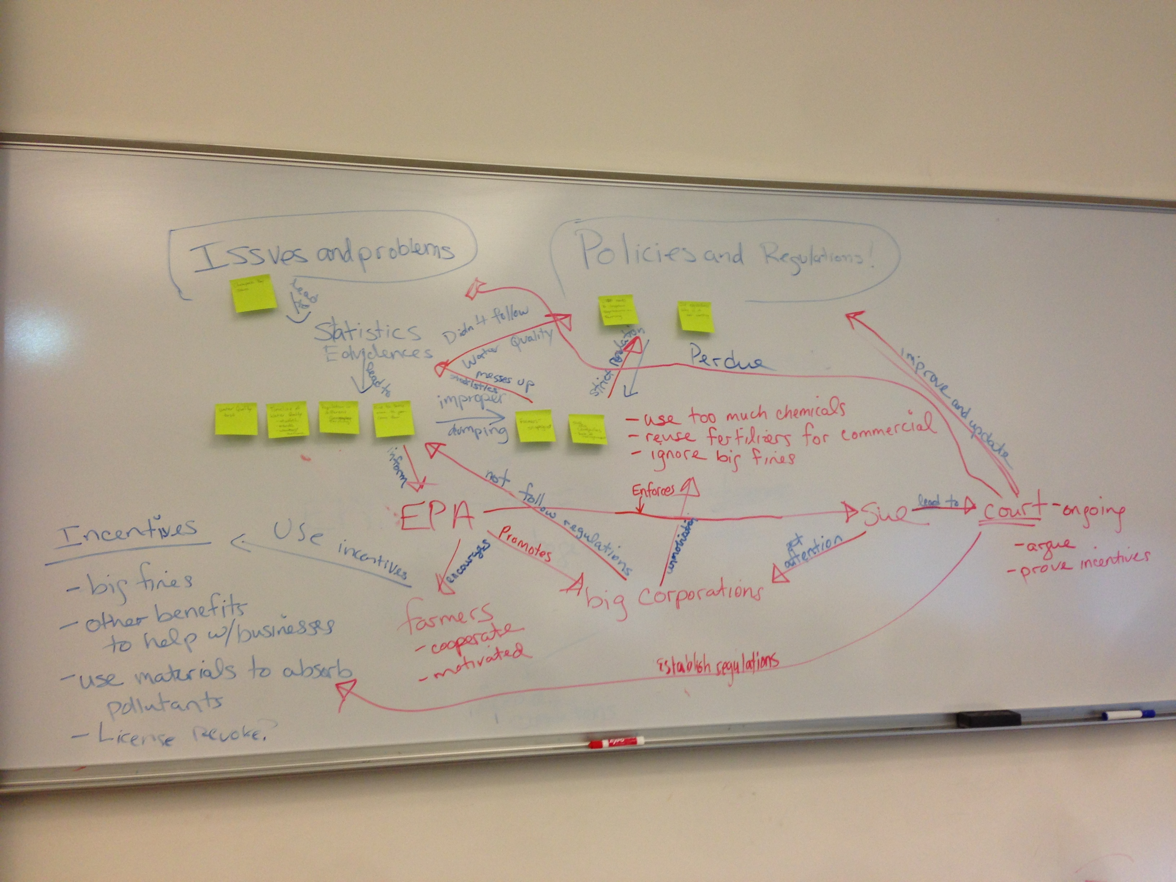

Slide 30
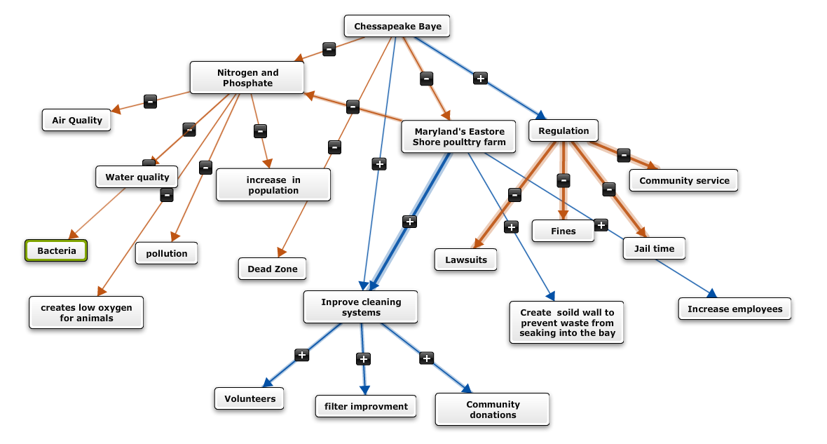

Slide 31
